Slide 1
AI and Chess Variant Sprint 3
Lydia Vaine, Timothy Youngblood, Ryan Long, Paul Neamtu, Souleymane Camara

Slide 2
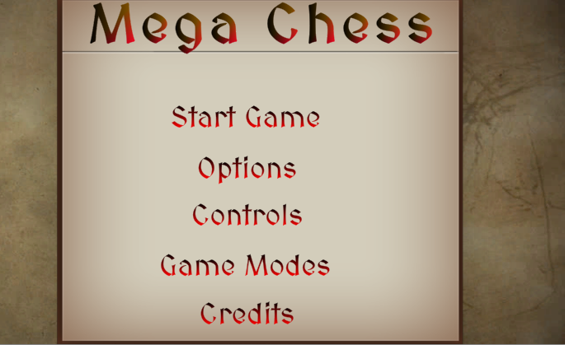
GUI redesign and polish
All scenes and scene features have been updated
All scenes have been reworked to improve readability including pause menu and in game GUI.
Flow between menu options is better.

Slide 3
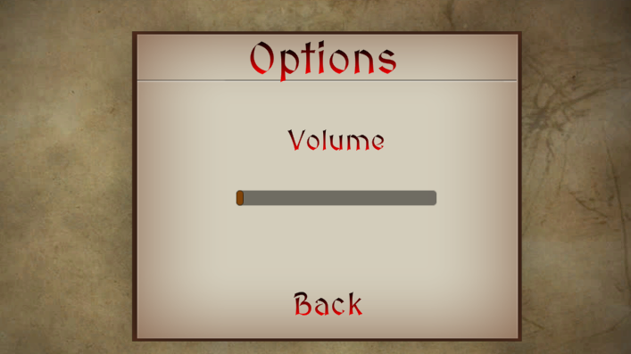
Volume controls
Volume controls adjustments added to slider
Stays in effect in main game scene as well as saves player option

Slide 4
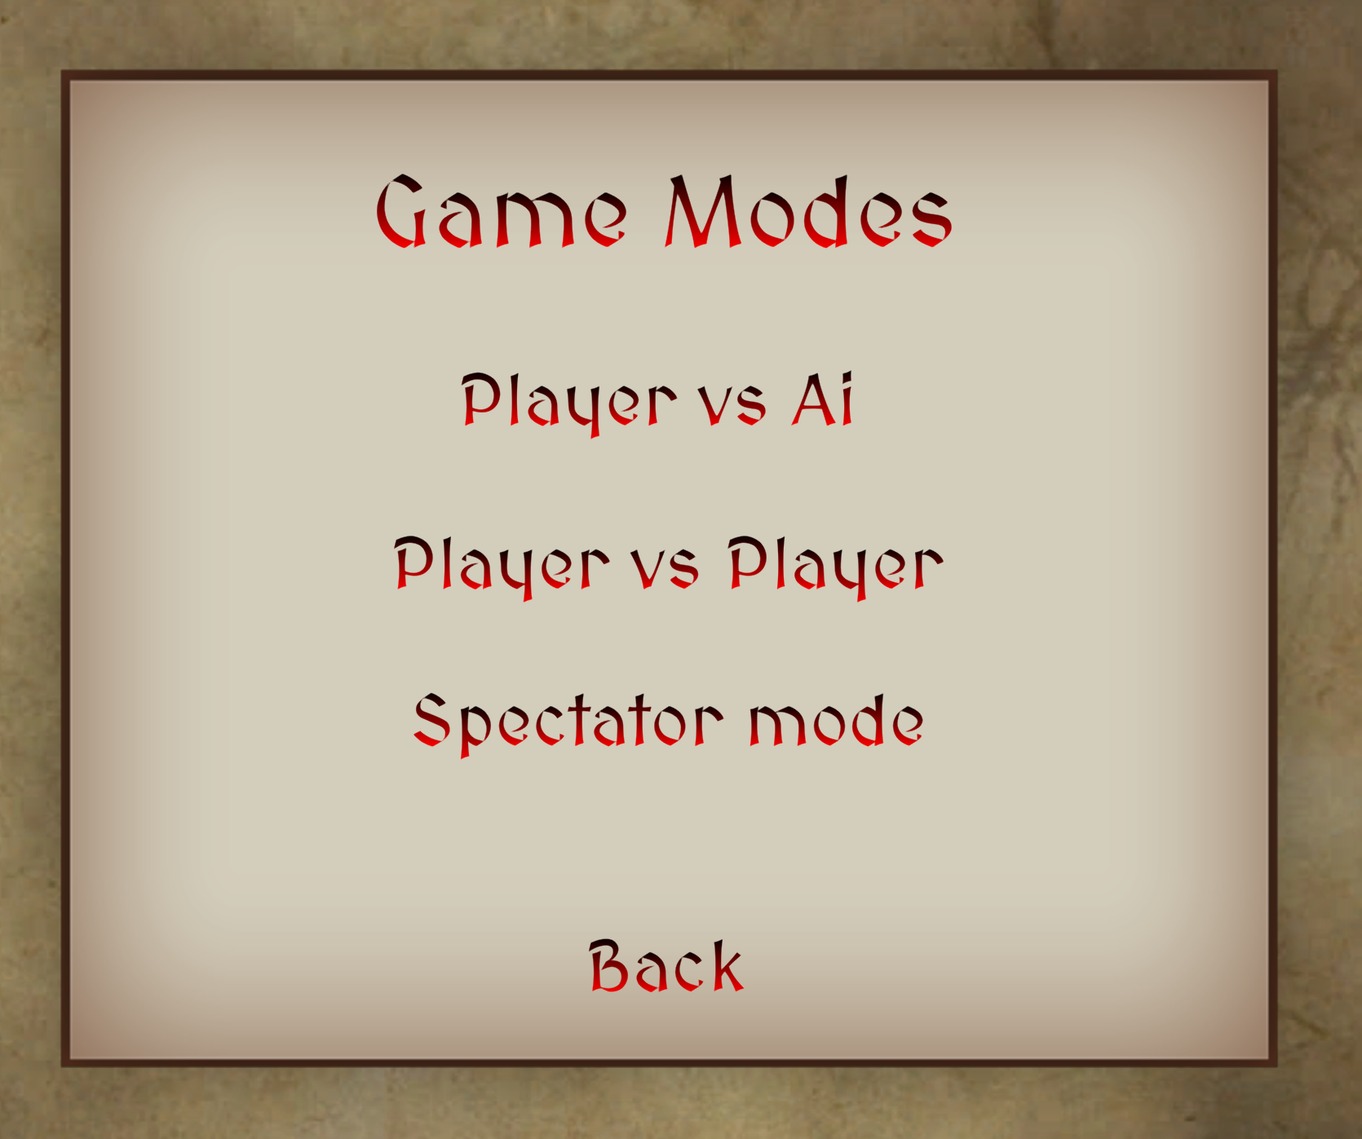
Game Modes
Passes user choice from GameMode scene to GameManager in MainScene
PvP and PvAI works
Spectator Mode has some bugs

Slide 5

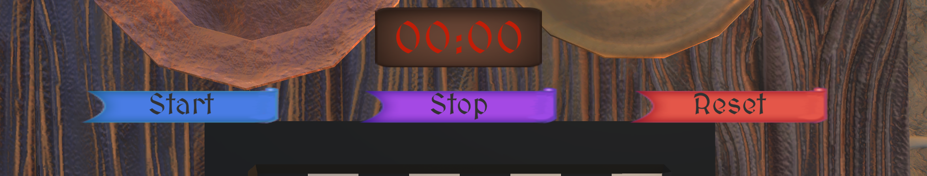
Load screen and timer addition
Load screen to load the main game scene implemented with working load progress bar
Timer for players to use to gauge game time like in many chess games.

Slide 6
Dice Debug and Integration
Dice bug-fixing
Resetting position between rolls
Proper value passed from dice roll result
Attack script created to integrate data from dice and calculate result

Slide 7
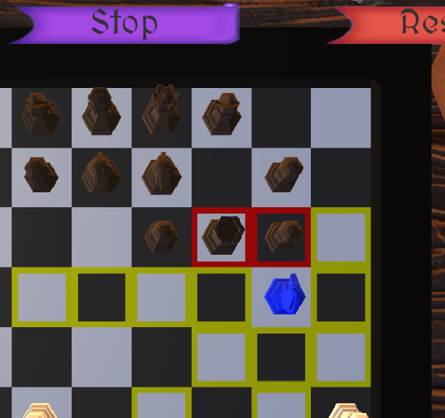
Attack Implementation - attackCells
attackCells list integrated into CommanderController
Adds red highlight functionality for valid attacks when moving pieces

Slide 8
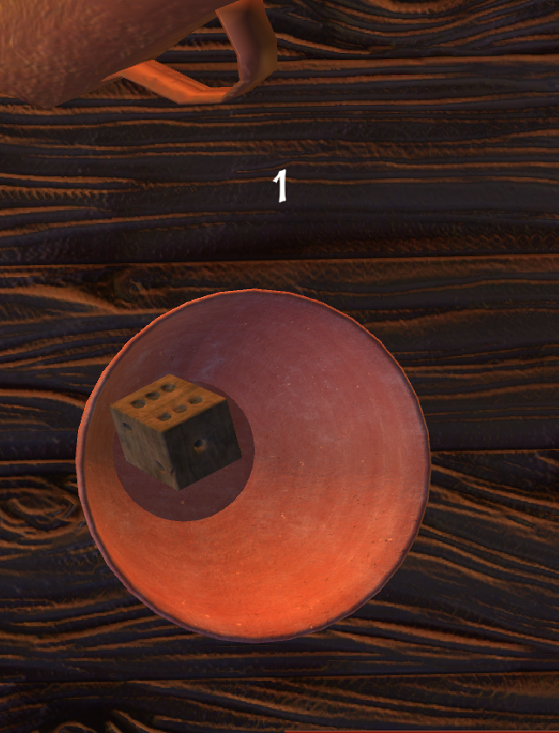
Attack Implementation - Dice Roll
Invokes an event that notifies Dice to roll
Waits for the responding event when the Dice roll has finished
Then checks IsAttackSuccessful
Dice roll result has a GUI text

Slide 9
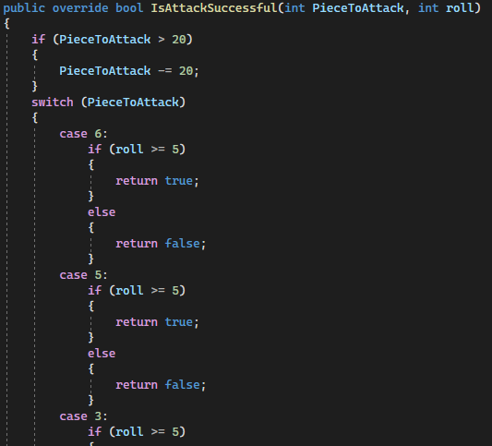
Attack Implementation - IsAttackSuccessful
Receives piece and dice roll data from IPieceBase
Top-side piece ID’s subtracted by 20 to identify piece type
Switch case used to check success criteria
Returns true if successful or false if not

Slide 10
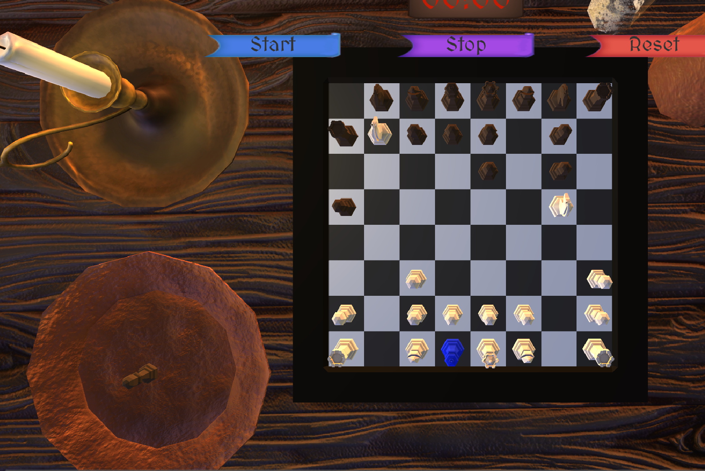
Attack Implementation - Finish successful attack
Moves attacked piece into deadpile
Tells GameManager to remove piece from the other’s player lists
Moves winning piece into the losing piece’s spot

Slide 11
AI MinMax
Created the minmax algorithm for the AI to be able to peek into the future and play less reactively.
Optimized the minmax algorithm through various means
Unity coroutine optimization
Piece AI “intuition”
Variable deepening

Slide 12
Heuristic
Further refined Heuristic function
Actions now scored based on four principle values
Piece protection
Danger level
Attack Value
Certainty
AI will value moves with higher certainty

Slide 13
AI Attack
AI uses the same events in AttackManager to invoke Dice rolls
AI waits for the returning OnDiceEnded event
Then uses the same IsAttackSuccessful on IPieceBase to determine success or failure passed on Dice number/roll

Slide 14
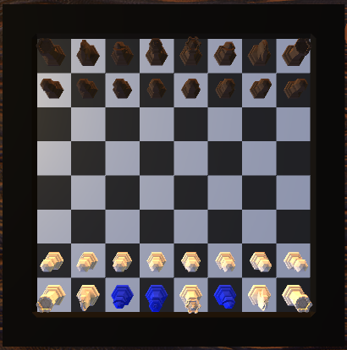
IMPROVING GAME BOARD
Instead of keeping the color in place of pieces, as we did in Sprint 2, we replaced them all including game board with 3D models unity assets.
Added environment and lighting

Slide 15
Scaling the UI component with the screen size
In order for the UI components to look more appealing in almost every device, we need to scale and resize them using Canvas

Slide 16
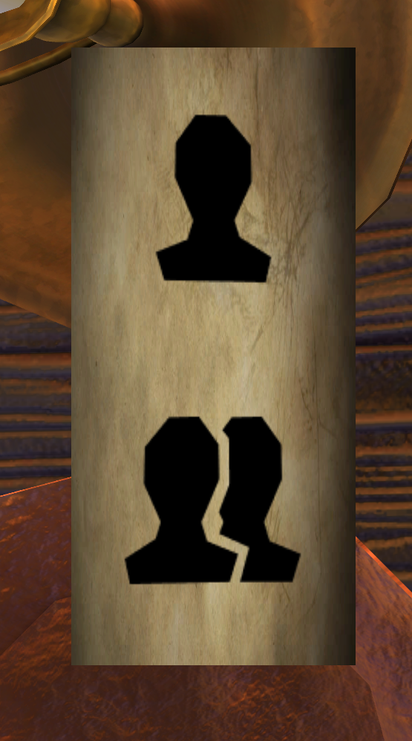
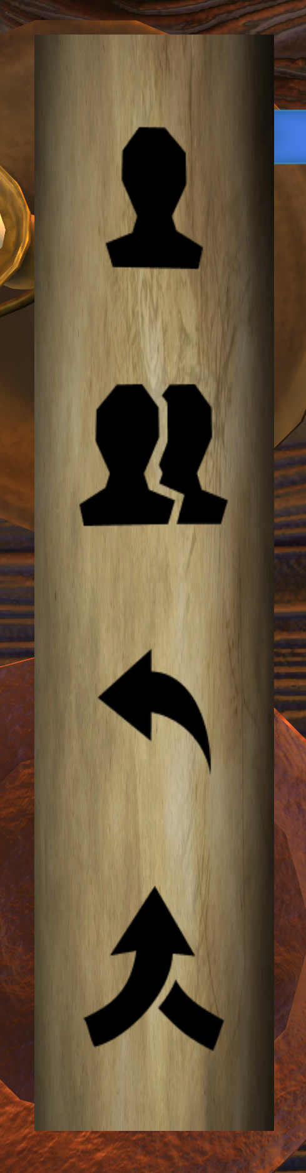
Player Commander Menu Icons
It was necessary to set icons for King Menu and Bishop Menu, that is to make it easier to select which player action, move commander(self) icon, move commanding piece(other) icon, delegate icon (for the king), and Recall delegate icon (for the king).

